Slide 1

May the Work Force..
Be With Us

Slide 2
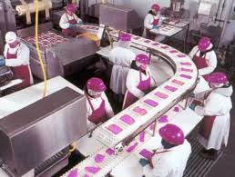
Yesterday’s Job Expectation:
https://www.youtube.com/watch?v=HnbNcQlzV-4

Slide 3
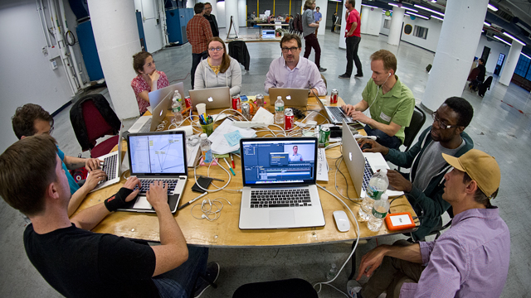
Today’s Job Expectation:
https://www.youtube.com/watch?v=1cYzkyXp0jg

Slide 4

Ten
Moves to
Transform
Student
Preparation

Slide 5


Static to Learning Organization
Scattered to Focused Priorities Independent to Collaborative Thinking
Linear to Triangular Measures of Progress
Shifts
Balances
Data with Outcomes
Knowledge with Understanding (transfer) Listening with Talking
Doing with Metacognition (thinking)
Simple with Complex Success at School with Success on the Job

Slide 6

What are the “residuals”
that we want kids to be left with?
Notes:
Give time for participants to talk.
Chart answers

Slide 7
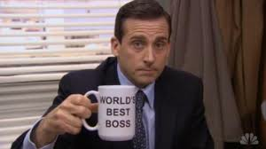
Employers want traits that cannot be tested…
Create
Innovate
Think Analytically
Problem Solve
Communicate
Collaborate
Work
Prioritize
Analyze
Seek Understanding
Seek Knowledge
Work Independently
Notes:
Each participant will have an index card. They will write a question on one side. They will brainstorm with partner a list of student outcomes.

Slide 8

Building Partnerships
Collaborative Thinking

Slide 9
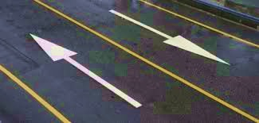

What do kids want?
Employers

Slide 10



Slide 11
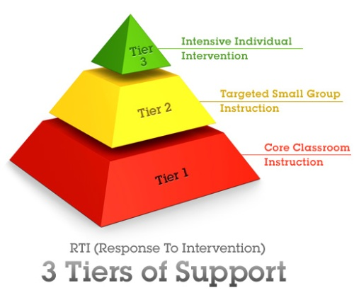

Slide 12

Efficacy & High Expectations
Student Ownership & Independence
Collaborative Professional Learning
Using Results to Drive Improvement
Relevant & Challenging Instruction
Windows of Common Practice

Slide 13
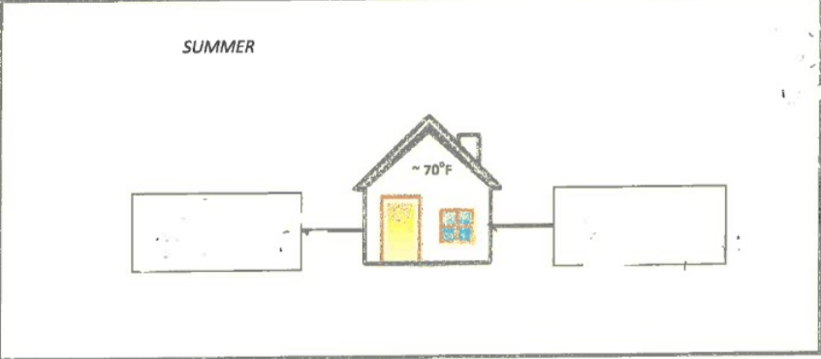
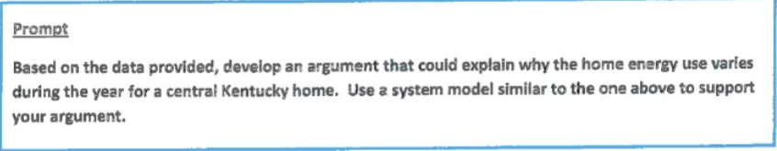
Simple - Complex

Slide 14
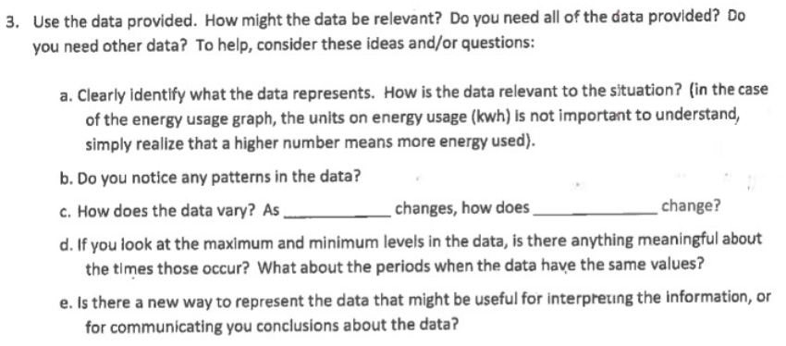
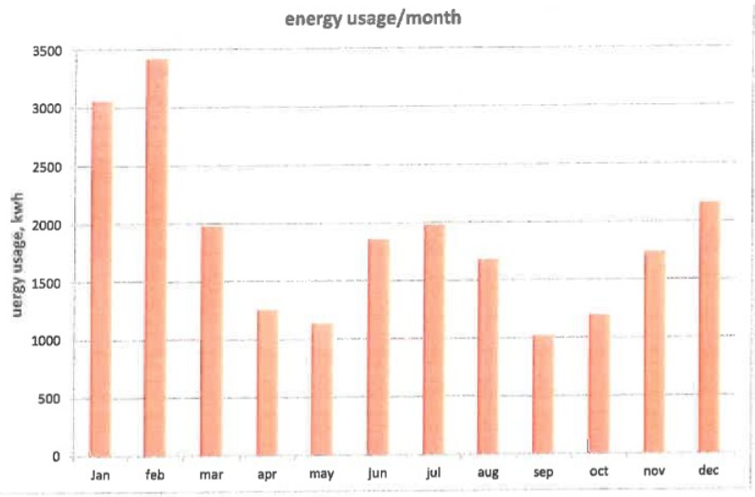
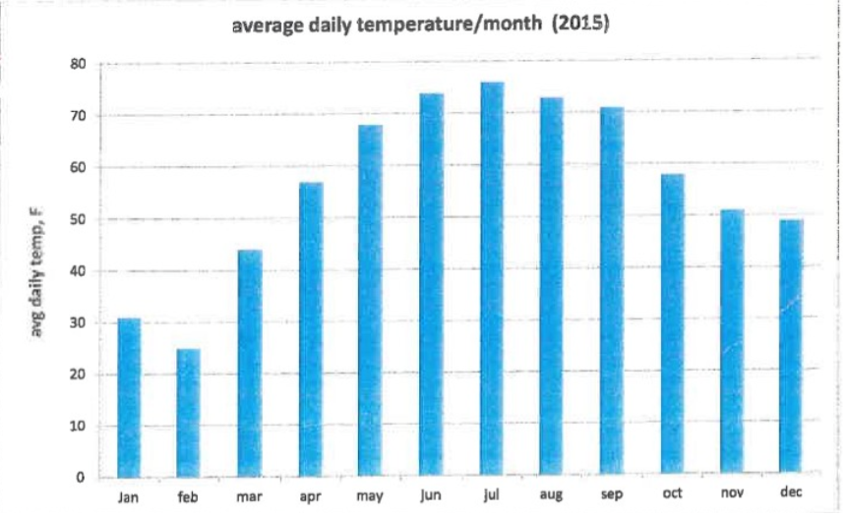

Slide 15
What Works Best?
Discussion/Discourse .88
Questioning .46+
Productive Struggle .64
Cognitive Demand .60
Assessment Capable Learner 1.44
Formative Assessment .70
Feedback .73
Teacher Clarity .75
Micro Teaching .88
Data Teams .90
Writing .82
Comprehension Strategies .72
Student Self Efficacy .80

Slide 16

ACS Graduate
Outcomes
Ask thought provoking questions as a means of understanding a problem or concept.
Engage in dialogue/discussion while working with others to identify and solve problems.
Persevere through challenging problems and situations by using various strategies and techniques.
Are aware of how they learn best and use that knowledge to pursue personal success.
Determine what must be done to complete a task/job successfully.
Make sense of a variety of complex media.
Prioritize information and make inferences that lead to new understandings.
Display confidence in their ability and are not afraid of mistakes or struggle in a quest for improvement.
Notes:
Each participant will have an index card. They will write a question on one side. They will brainstorm with partner a list of student outcomes.

Slide 17

Student Ownership & Independence
Cause | Danielson Framework | Strategy | Effect | M | Effect Measure
Goal | Teacher/Student Moves | Research |  |  |  | Impact
Engaging questions are posed by the teacher and students in 80% of classrooms on a given day. | 3B Teacher uses a variety or series of questions/prompts to challenge students cognitively... | Questioning Discourse | .46+ .88 |  |  | Ask thought provoking questions as a means of understanding a concept or problem.
 | 3B Students formulate questions, initiate topics, make contributions.
 | 3B Students initiate higher-order questions.
Implementation

Slide 18
Triangular Measures of Progress
Quantitative Data
STAR Results
Quarterly Results
Effect Size
KPREP/EOC
School Level
Observation Data
Peer Observation
Questionnaire
District Level Rounds Team
Collect data 3x year
During class visits

Slide 19
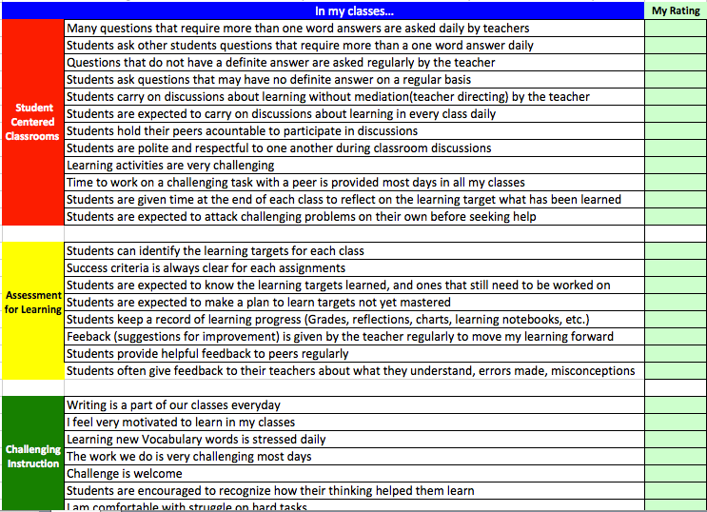
Questionnaire

Slide 20
Static to Learning Organization
Student Ownership & Independence
Goal | Danielson Framework | Actions | Timeline | Training | Monitoring | Impact/ Outcome
Engaging questions are posed by the teacher and students in 80% of classrooms on a given day. | 3B Teacher uses a variety or series of questions/prompts to challenge students cognitively... |  |  |  |  | Ask thought provoking questions as a means of understanding a concept or problem.
 | 3B Students formulate questions, initiate topics, make contributions.
 | 3B Students initiate higher-order questions.
Strategic Map

Slide 21
Collaborative Professional Learning
Cause | Danielson Framework | Strategy | Effect | Effect Measure
Goal | Teacher/Student Moves | Research |  | Impact
All teachers participate in collaborative planning, observing, and analyzing instructional practices using Lesson Study protocol. | 4D Teacher actively participates and or takes a leadership role in promoting a culture of professional inquiry. | Collaborative Lesson Study (Micro-teaching) | .88 | Ask thought provoking questions as a means of understanding a concept or problem.
 | 4D Teacher makes a systematic effort to conduct action research.
 | 4D Teacher welcomes colleagues and supervisors into the classroom for the purpose of gaining insight from their feedback.
Use data to collaboratively make instructional decisions. | ...includes teacher as well as student use of assessment. ..teacher intends to use assessment results to plan future instruction. | Formative Evaluation (Data Teams) | .90
Efficacy

Slide 22

Doing Metacognition (Thinking)
Use Schema to make sense of information
Determine Importance to prioritize
Synthesize Information to combine several view points
Visualize to see what could be
Ask Questions to push thinking
Make Inferences to draw conclusions
Notes:
Each participant will have an index card. They will write a question on one side. They will brainstorm with partner a list of student outcomes.

Slide 23

Howard
Jackson
Craft
Stephens
York

Slide 24
What are the qualities of a good learner and successful student?
Success at school and work
We asked Kids…

Slide 25
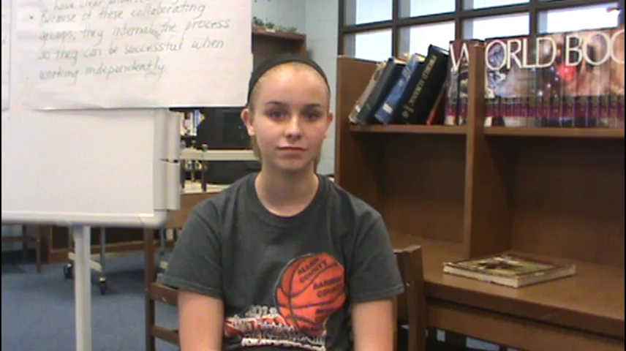

Slide 26
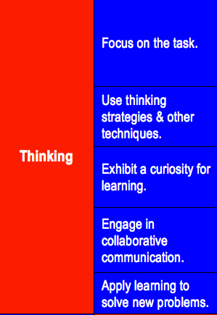
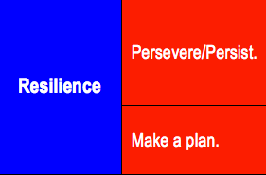
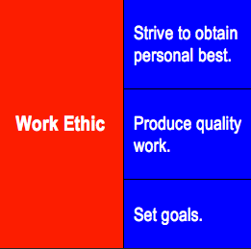
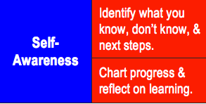
Qualities of Good Learners
Workers
Notes:
Each participant will have an index card. They will write a question on one side. They will brainstorm with partner a list of student outcomes.

Slide 27
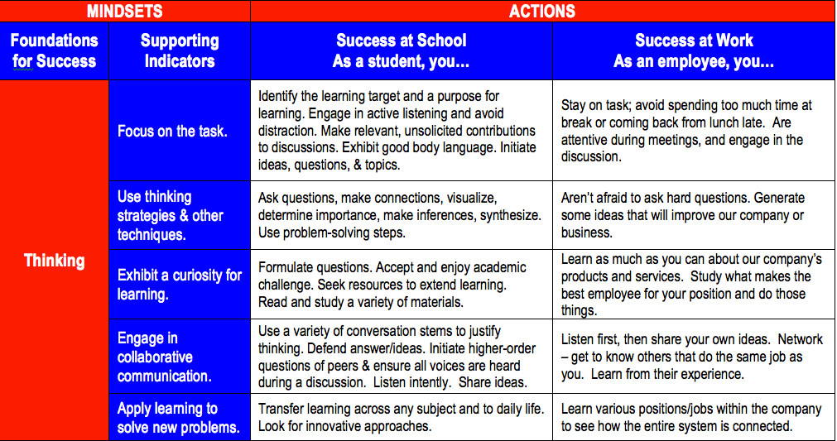

Slide 28
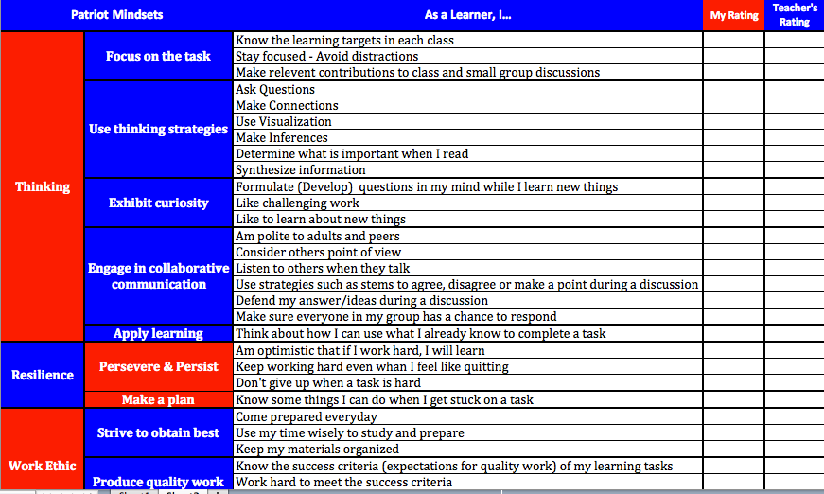
Student Self-Awareness Tool

Slide 29
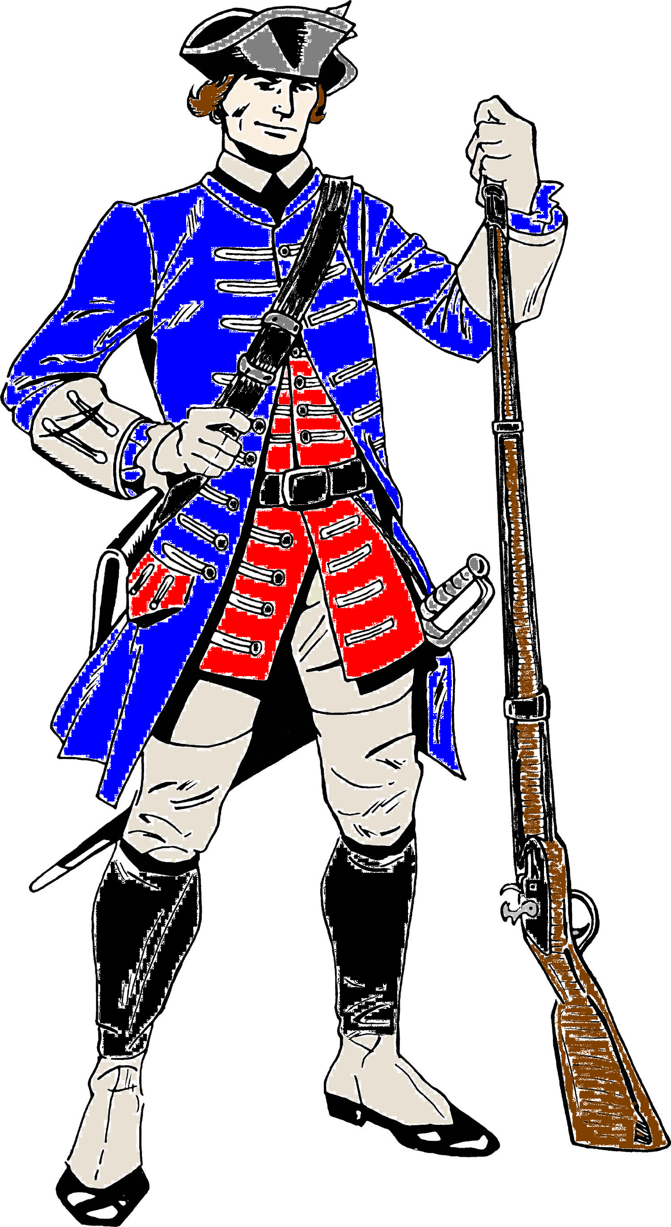
www.allen.kyschools.us
Patriots are
Certified For LIFE

Slide 30
Intervention classroom
House to House
Core Classroom &
Intervention classroom

Slide 31
ECE
Reading Novice
Math Novice

Slide 32
ECE
Reading Combined P&D
Math Combined P&D

Slide 33
Reading Novice 2012-2015

Slide 34
Math Novice 2012-2015

Slide 35

Thanks!
Randall Jackson – Superintendent – Allen County Schools
Rick Fisher – Director of Instruction – Allen County Schools

Slide 37


Smart
Effort

